Slide 1
Impact of Water Resources Management practices on Health Policies Avinash C Tyagi Secretary General, ICID
16th African Water Association Congress
20-23 February 2012, Marrakesh, Morocco

Slide 2
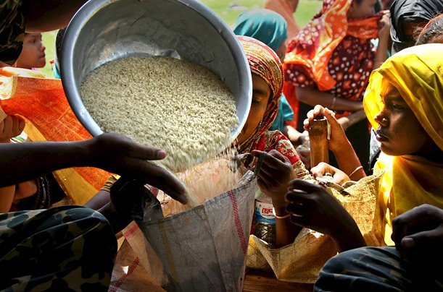
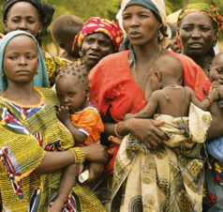
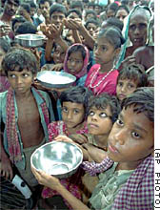
World agriculture faces an enormous challenge over the next
40 years to produce almost 50% more food up to 2030 and
double the food production by 2050
Key drivers
Increasing population and urbanization
Changing diets
Rapidly growing water demand from industrial/energy, and domestic sectors
Increasing area under bio-energy crops
Climate change impacts
Increasing fresh water scarcity

Slide 3
Global freshwater use: projections
Electricity
Domestic
Source: OECD Environmental Outlook baseline (2008)

Slide 4
Contribution of NCWR such as WW
Wastewater (raw, diluted or treated) is a resource of increasing global importance, particularly in urban and peri-urban areas due to growing wastewater volumes
Without proper management, wastewater use poses serious risks to human health and the environment
With proper management, wastewater use can contribute significantly to sustaining livelihoods, food security and the quality of the environment
Wastewater already irrigates approximately 49 million acres of cropland, and
10 per cent of the world's population would starve if they didn't have access to food grown that way

Slide 5
Wastewater irrigation
In majority of the urban areas, the activities in the wastewater sector are focused mostly on wastewater disposal than recycle and reuse recycle
benefits of wastewater farming far outweigh the drawbacks
reuse of wastewater has not received much attention by the policy-decision makers perhaps because of the lack of viable models with necessary research and technology support,
strong policies and legal framework at the national and state levels and sufficient trained manpower in the urban local bodies are required.

Slide 6
Benefits of wastewater use
Direct benefits
Recycles and thereby conserve water,
Recycles nutrients, thereby reducing the need for farmers to invest in chemical fertilizer, and
Provides a reliable water supply to farmers particularly in low-income dry areas;
Indirect benefits
Prevents of pollution of rivers, canals and other surface water that would otherwise be used for the disposal of the wastewater, and
Disposes municipal wastewater in a low cost and hygienic way.

Slide 7
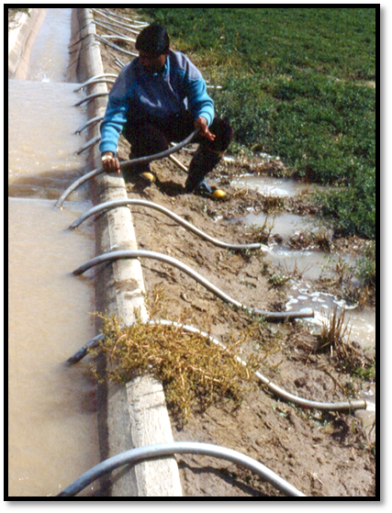
Is there need for a policy?
Wastewater as a new resource
Treated, partially treated, diluted or raw wastewater uses
Health risks management issues
Nutrient and land management
Economic considerations
Socio-cultural acceptability

Slide 8
Policy elements
Is there a need for wastewater treatment and reuse?
How is greywater treated and reused?
How to achieve the objectives of wastewater use with maximum benefits with minimized environmental and health implications?
How to get the institutions work together?

Slide 9
National Health Policy
Objective: “…to achieve an acceptable standard of good health amongst the general population of the country…..”
Recognize:
“ …that the ambient environmental conditions are a significant determinant of the health risks to which a community is exposed; such as unsafe drinking water, unhygienic sanitation and air pollution significantly contribute to the burden of disease, particularly in urban settings”.
“ that the work conditions in several sectors of employment can be sub-standard effecting the health of the workers…”

Slide 10
National Water Policy
Objective: “…to meet all the needs of water: drinking agriculture, hydropower, ecological…..”
Recognize:
“ … the various available water sources are distributed in time and space which do not match the demand and sets out ways and means to harness all available sources….”.
“ … the need to recycle and reuse….”
But often fail to:
Include wastewater in their water budgets
Recognize the intricacies of urban hydrologic cycle
Set up institutions that cross-over the boundaries of waste water management in urban setting and irrigation management

Slide 11
Disaster Management Plans
Objective: “…to reduce the adverse impacts of extreme events such as droughts and floods (for example)…..”
Recognize:
“ … the risk (floods or drought) assessment as a means to take preventive and prepare post disaster preparedness plans….”.
“ … ….”
But often fail to:
Assess health risks, particularly due to flooding of chemical factories, wastewater treatment plants and wastewater agriculture fields

Slide 12
Urban Flood Management
Risk Management
Sustainable Urban Drainage Systems
Principales
SPATIAL PLANNING
IWRM
Plans
Basin
Flood Management
Plans
Storm
Water Management
Plans
Plans
LAND USE PLANNING
Integrated Flood Management
Coastal Zone Management
Total Water Cycle Management
Concepts

Slide 13
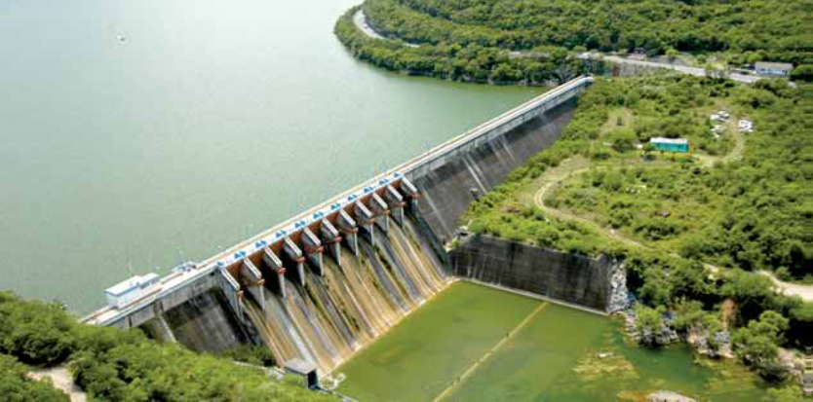
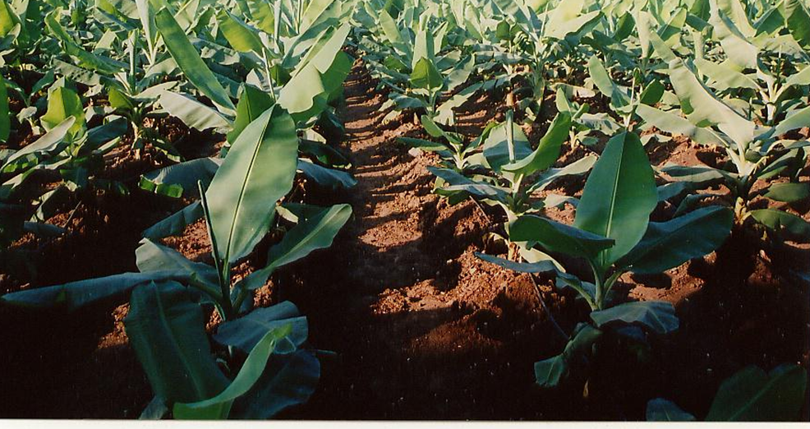
Policy Framework
Inter
national
National
Local
Policy
Legislation
Institutional framework
Regulation application

Slide 14
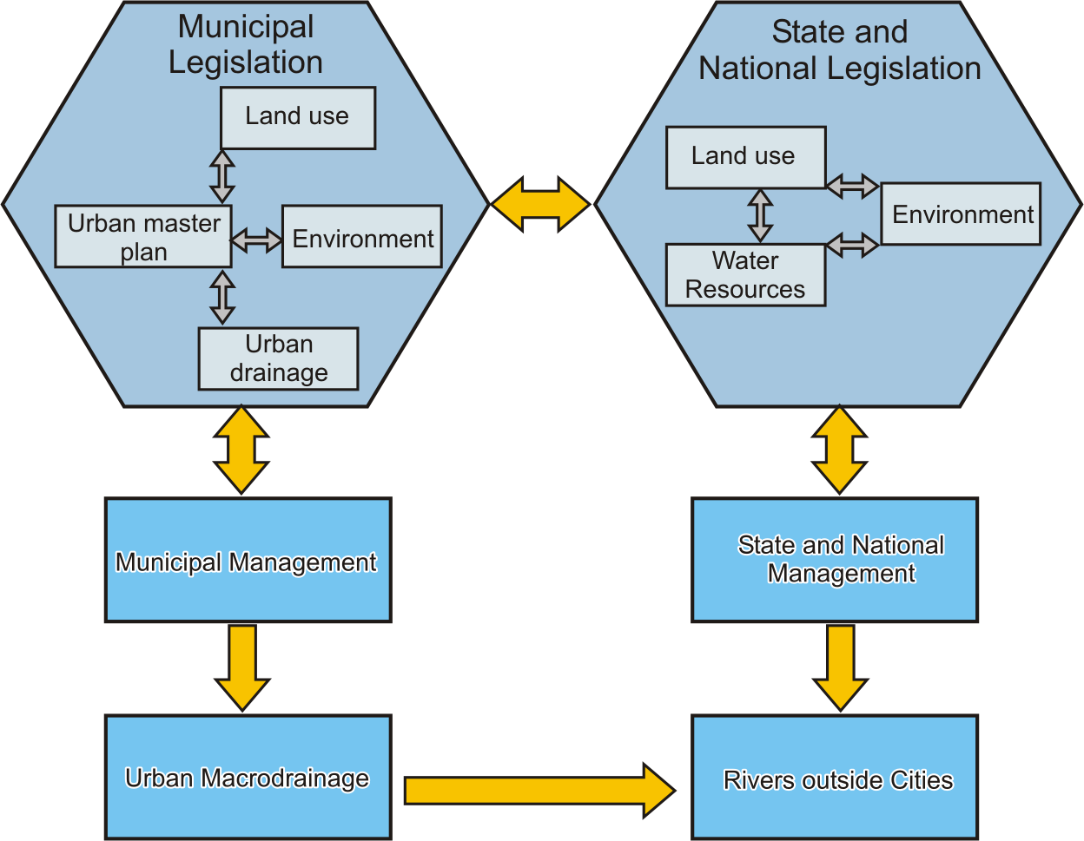
Legal and Institutional Framework

Slide 15
Associated Requirements
National policies and strategies
Legal control regulations based on realistic standards
Promoting research for better understanding of the problem and interdependencies
Monitoring and evaluation of wastewater generation and use
Institutional manageability through inter-disciplinary institutions
Application of holistic health guidelines
Information, tools, techniques and technologies
Training and human resources development
Societal participation and awareness building

Slide 16
THANKS
For more visit
www.icid.org

